Slide 1
President’s Diversity, Equity, and Inclusion Task Force Town Hall
Advocacy and Partnerships

Slide 2
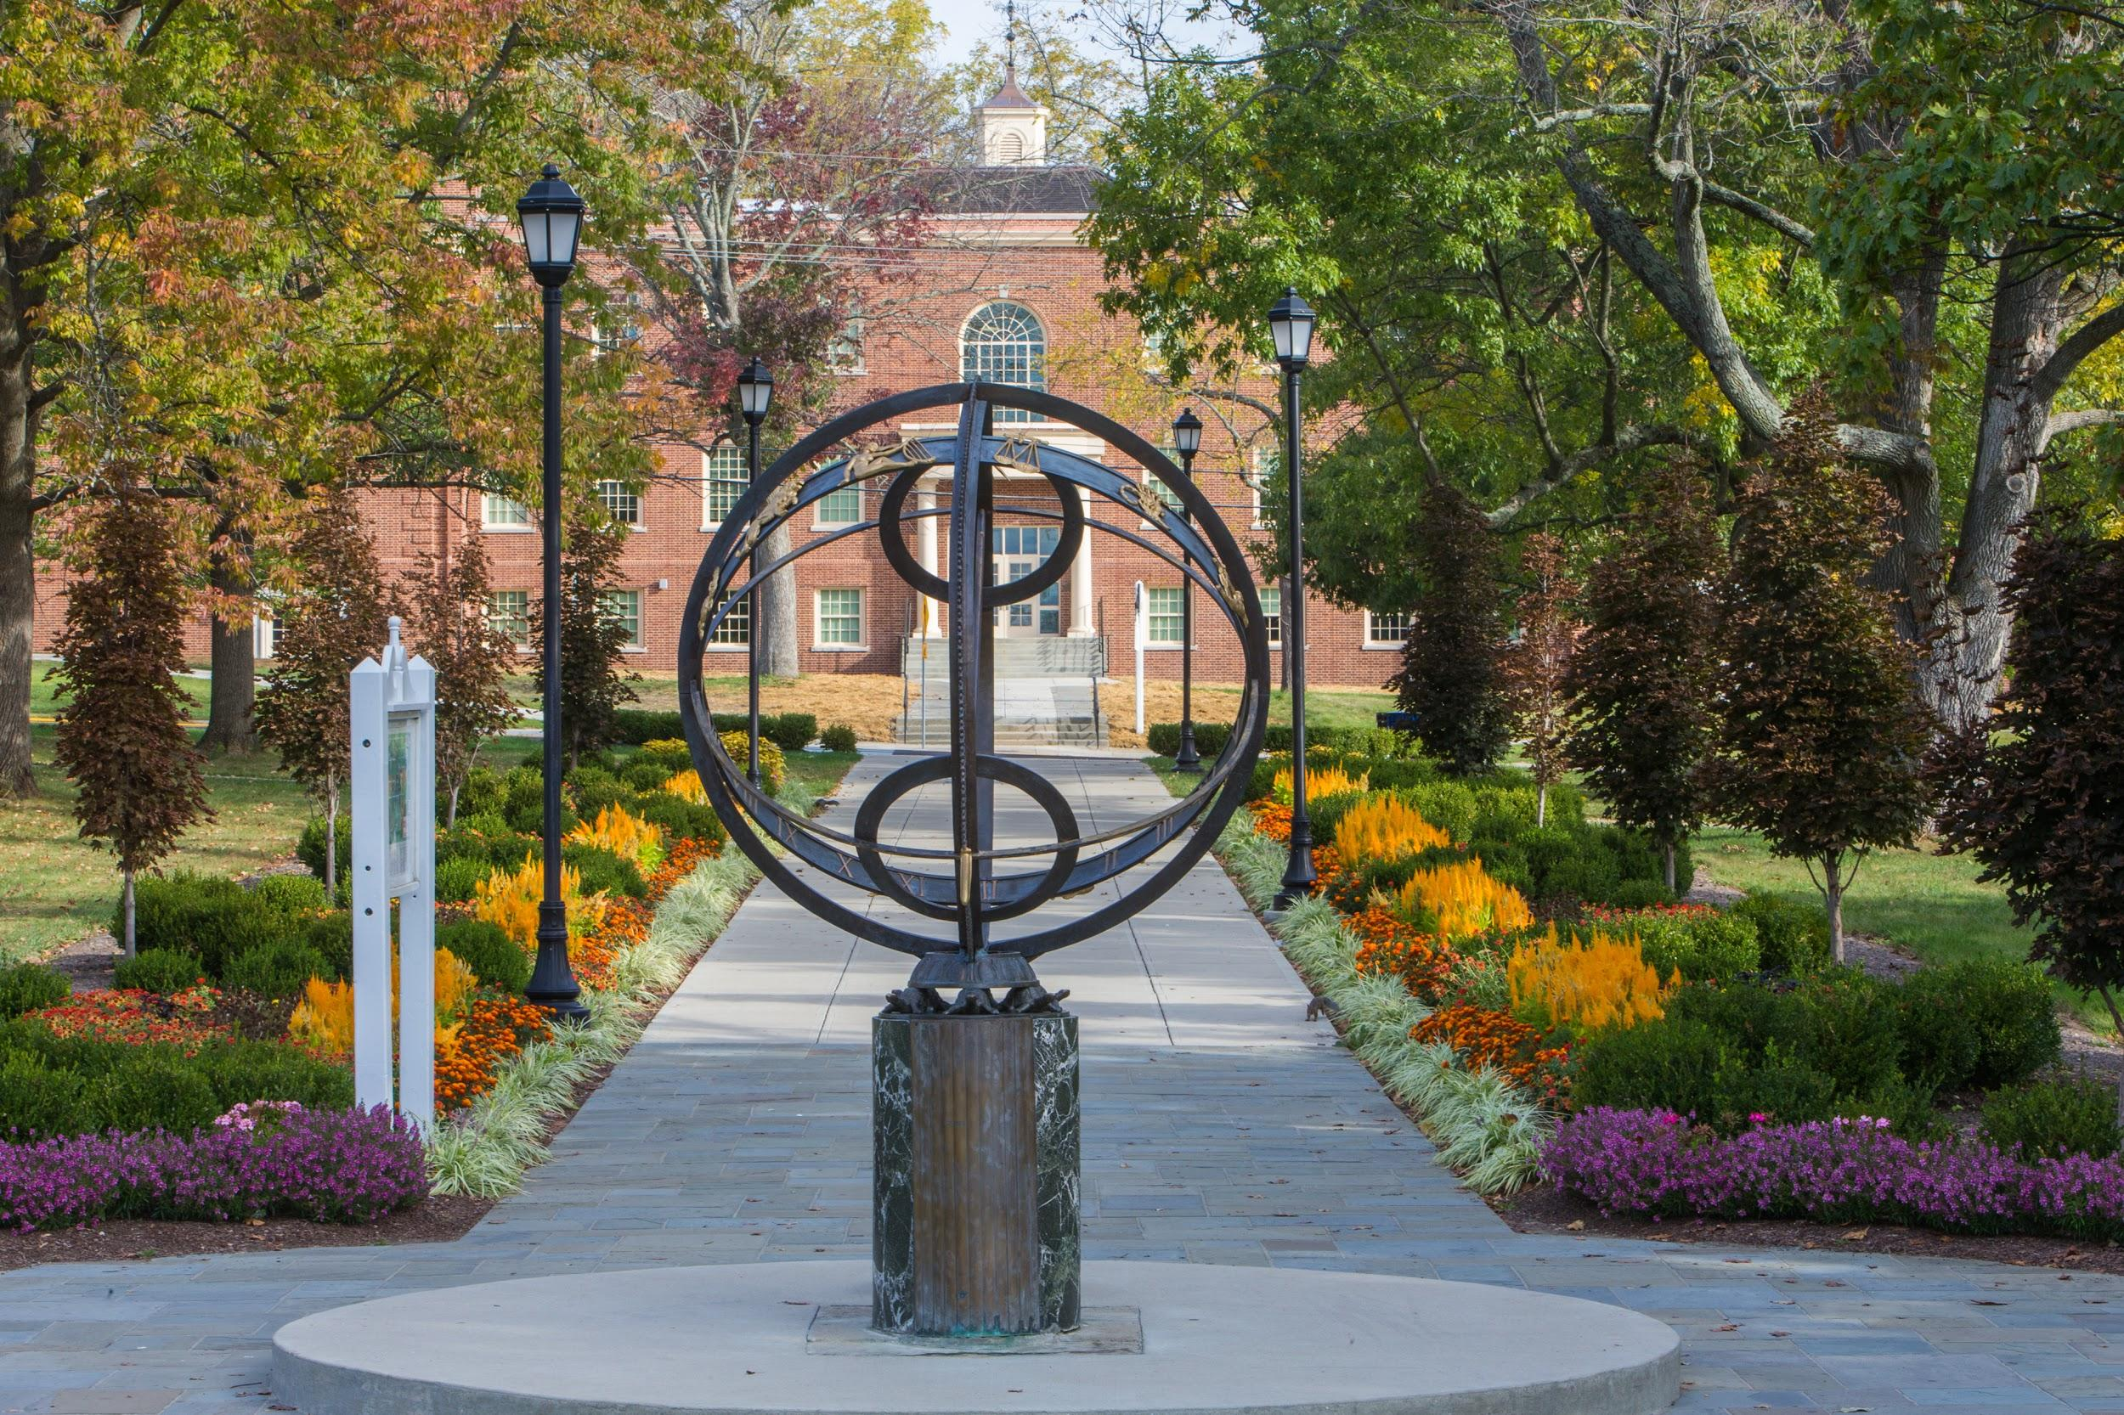
Agenda
Our Time Together
Explanation of Pillar via the President’s Charge
Subcommittee’s Interpretation and Discussions
Preview of Recommendations
Opportunity for Audience Engagement

Slide 3
Subcommittee Members
Darryl B. Rice, PhD, Assistant Professor of Management, Farmer School of Business
Rodney Coates, PhD, Professor of Critical Race and Ethnic Studies Global and International Studies
Amber Franklin, PhD, Associate Professor of Speech Pathology and Audiology, Chief Departmental Advisor
John Forren, PhD, Executive Director, Miami University Menard Family Center for Democracy, Associate Professor and Chair of Department of Justice and Community Studies
Chuck Martin, Head Football Coach
Sgt. Susan Tobergte, Miami University Police Department
Mike Smith, Mayor of Oxford
D’Angelo Solomon, Associate Athletic Director of Revenue Generation
Amy Shaiman, Application Team Leader
Jannie Kamara, Student Body President
Vada Stephens, ASG Academic Senator, PR of Black Student Law Association
Sydnie Singleton
Serenity Kemp

Slide 4
Charge of Advocacy and Partnerships Subcommittee
Beyond listening, dialogue and cultural competency, we need plans for action and change. Students need to learn how to become effect advocates, responsible allies, engaged citizens, and future leaders who will bring about positive, lasting change at Miami, in Oxford, in their local communities, in the state, and in the nation.

Slide 5
Subcommittee’s Interpretation and Discussions
What is an effective advocate?
A person who or organization that publicly supports or recommends a particular cause or program and is successful in producing a desired or intended result/outcome.
What is a responsible ally?
A person or organization with an explicit and direct partnership with another person or organization rooted in a sense of obligation, care, and/or concern. (Typically an ally is someone from a non-marginalized identity, so context matters).
We must avoid “performative allyship” (condemning racism, sexism, discrimination, and/or systemic oppression but enabling or allowing its effects in the organization/institution)
Effective advocates and responsible allies have “moral courage.” Moral courage is the willingness to take action for ethical reasons despite the risk of adverse consequences.

Slide 6
Key Internal Partnerships
Office of Institutional Diversity, Center for Student Diversity and Inclusion, Office of Residence Life, Office of Greek Life, Faculty Senate, Miami University Police Department, Association of Black Faculty and Staff, Asian and Asian American Faculty and Staff Association, Association of Latino/a Faculty and Staff, International Faculty and Staff Association, University Athletics, Student Success Center, various DEI units within colleges
Association of Student Government, Graduate Student Association, Graduate Student of Color Association, Diversity Affairs Council, student-athletes, Redhawk COUNTS, Unidos, Black Student Action Association, Hillel, Janus Forum, Greek-lettered organizations

Slide 7
Key External Partnerships
City of Oxford, Oxford NAACP, Oxford Police Department, Oxford Police Community Relations and Review Commission, Western College Alumni Association, Black Alumni Association, Cincinnati Public Schools, employers who value DEI, alumni supporting DEI

Slide 8
Preview of Recommendations
Expand our partnership with Cincinnati Public Schools to include Dayton and Cleveland https://miamioh.edu/news/top-stories/2017/08/cincinnati-public-schools-miami.html
Commit significant recruiting resources to minority-majority cities and Title 1 high schools https://www2.ed.gov/programs/titleiparta/index.html
Identify and partner with organizations such as The PhD Project to increase faculty diversity https://www.phdproject.org/
Increase resources to NPHC and multicultural organizations
Have key internal and external partners rotate hosting responsibilities for monthly “Advocacy and Allies” happy hour events
Establish study away/teach away programs (semester long) with historically Black colleges and universities (HBCUs) and Hispanic-serving institutions (HSIs)
Provide teaching and research grants for faculty and students whose work contribute to overturning systemic oppression and biases that impede the ability of minorities and other marginalized groups
Establish and empower a Title VI Office to investigate and make findings regarding racial harassment and discrimination complaints on campus https://www2.ed.gov/about/offices/list/ocr/docs/hq43e4.html
Revise Student Code of Conduct to explicitly include Title VI under Prohibited Conduct section https://miamioh.edu/policy-library/students/student-code-of-conduct/prohibited-conduct.html

Slide 9
Big idea for a positive lasting and transformative change
Establish a Center for Justice, Advocacy, and Community Engagement (JACE Center)
The vision is for a full-time faculty/staff with JACE expertise (social/organizational justice, diversity, equity, inclusion, community/civic engagement, etc.) to lead this work and direct the center with a committee made up of faculty, staff, and student representation who will give programmatic recommendations in terms of combating systemic oppression and bigotry and guide the trajectory of the center based on the five pillar of 1) Open Dialogue and Allyship, 2) Cultural Competency, 3) Advocacy and Partnerships, 4) Structural and Resource Support, and 5) Inclusion and Accountability.
Objective: To structurally and culturally imbed JACE principles into the Miami experience in effort for students, faculty, and staff to become effective advocates, responsible allies, engaged citizens, and leaders who will bring about positive, transformative, lasting change at Miami, in Oxford, in their local communities, in the state, and in the nation.

Slide 10
Big idea contingency
Miami Coalition for Justice, Advocacy, and Community Engagement (JACE) – proposed by Jannie Kamara
The vision is to strategically build a coalition of various JACE (social/organizational justice, diversity, equity, inclusion, community/civic engagement, etc.) partnering campus divisions/units/faculty/staff/students/student organizations to lead this work and direct the coalition who will give programmatic recommendations in terms of combating systemic oppression, discriminatory biases, bigotry and guide the trajectory of the coalition based on the five pillar of 1) Open Dialogue and Allyship, 2) Cultural Competency, 3) Advocacy and Partnerships, 4) Structural and Resource Support, and 5) Inclusion and Accountability.
Objective: To structurally and culturally imbed JACE into the Miami experience in effort for students, faculty, and staff to become effective advocates, responsible allies, engaged citizens, and leaders who will bring about positive, transformative, lasting change at Miami, in Oxford, in their local communities, in the state, and in the nation.

Slide 11
Institutional Response to Discriminatory Statements and Behavior (Differing viewpoints within the subcommittee)
Private citizen’s 1st Amendment right vs Public employer’s interest in an efficient, disruptive-free institution (Pickering-Connick Test) (Pickering v. Board of Education, 391 U.S. 563, 1968) (Connick v. Myers, 461 U.S. 138, 1983)
Finding that concern for the potential disruption caused by engendering and perpetuating a public perception of a public employer as racially insensitive was a reasonable motive for the public employer to terminate public employees’ employment (Locurto v. Giuliani, 447 F.3d 159, 2d Cir. 2006)
Finding that a public employee holding confidential or policymaking position (university administrative position) that made homophobic statements was a reasonable motive for a termination of public employee (Dixon v. University of Toledo, 702 F.3d 269, 6th Cir. 2012)
Key legal factors: Avoiding disruptions in regular operations, maintaining good working relationships among coworkers, avoiding erosion of working relationships dependent of confidence and loyalty, avoiding obstructions in employees’ abilities to perform their work

Slide 12
When blatantly discriminatory comments are made or clear acts of discrimination occur, do we have the moral courage to advocate for the University’s interest in an efficient, disruption-free institution?
Engenders and perpetuates public perception of the University being racially insensitive
Unexpected changes in standard faculty teaching load
Undermines the University’s interest/ability in avoiding legal and financial liabilities in Title VI investigations and litigations
Undermines the University’s interest/ability in recruiting faculty, staff, and students, particularly faculty, staff, and students of color
Undermines the University’s interest/ability in retaining faculty, staff, and students, particularly faculty, staff, and students of color
Undermines the University’s interest/ability in establishing and maintaining relationships with current and potential employers for students graduating and seeking internships
Adversely impacts perpetrator working relationships with other departmental members and students within major, particularly graduate students
Perpetrator is unlikely to be assigned committee work on behalf of the department, college, and University
Loss of confidence in perpetrator by superiors (Department Chair, Dean, Provost, President)

Slide 13
Concerns That Require More Discussion
Ability to be exploited for any comment perceived to be insensitive
Who determines what qualifies as racist, sexist, homophobic, or discriminatory
Ensure due process of the accused to defend themselves against the allegations and provide the ability for cross-examination (anonymous complaints are problematic in this regard)
Ensure a neutral fact-finder (e.g., Title VI officer should not be judge, jury, and executioner).
Punishment for false allegations of discriminatory comments to prevent the weaponization of false allegations of racial harassment/discrimination
Protect the integrity of legitimate and truthful discriminatory claims

Slide 14
Start the Semester with Moral Courage
Encourage the Miami Community to wear Black Lives Matter shirts the first day of campus (idea recently suggested by Dr. Coates)

Slide 15
Opportunity for Audience Engagement
Q & A

