Slide 1
Across the Table: Strategies and Solutions for Living in a Collective Community
Liz Persaud
Assistive Technology Expert and Disability Connector

Slide 2
Knowledge has power and controls access to opportunity and advancement.

Slide 3
Why Am I Here Today?
Notes:
Liz

Slide 4
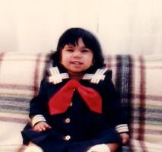
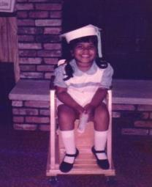
“She won’t and can’t be successful.”
My Parents were advised to put me in a school for individuals with developmental disabilities and took me out the next day when they realized that system was not designed for me.
“I will and can be successful”
Strong self-advocate, always wanting to help others, chosen as peer supporter to other students numerous times in elementary and middle schools. I always had good grades, made honor roll every year!
Notes:
Liz

Slide 5
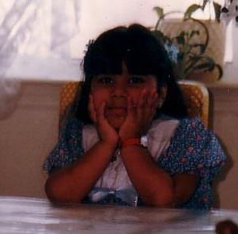
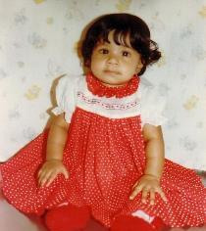
Me: Why Me? Me: Why Not Me?
Spinal Muscular Atrophy Type 2 ("ALS in children")
Official diagnosis, Dec 1979
Life Expectancy (Age 2, 7, 11 and now 43)
Progressive Muscle Weakness
Chronic Pain and Fatigue
Respiratory Complications
“What doesn’t kill you, makes you stronger.”

Slide 6
START AT THE BEGINNING
disability can often be a consequence of the environment
attitudes
stereotypes
barriers
misconceptions
ableism

Slide 7
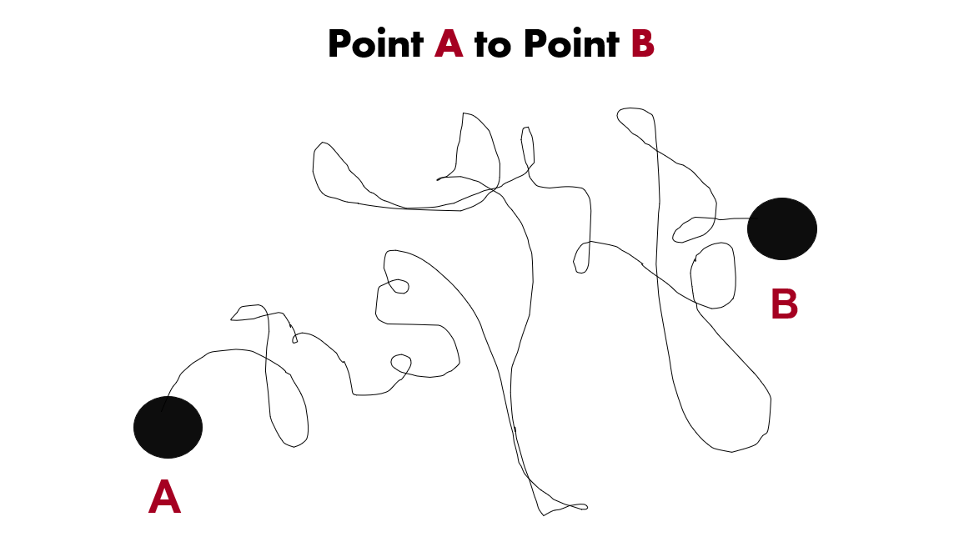
Point A to Point B

Slide 8
Disability is Natural
Disability is a natural part of the human experience and in no way diminishes the right of individuals to:
live independently;
enjoy self-determination and make choices;
benefit from an education;
pursue meaningful careers; and
enjoy full inclusion and integration in the economic, political, social, cultural, and educational mainstream of society in the United States.
Public Law 108-364

Slide 9
Give (and Get) Purpose
Hope
Fear
Pass
Strong
Independent
Resilient
Ability
Lovable
Hopeful
Fail
Weak
Dependent
Inflexible
Disability
Repulsive
Hopeless

Slide 10
I’ll Never Be Alone Every 1 in 4 or 26%
People with disabilities are the largest minority group in America
This group cuts across racial, ethnic, religious, gender and age boundaries
Anyone can become a member of this minority group at any time

Slide 11
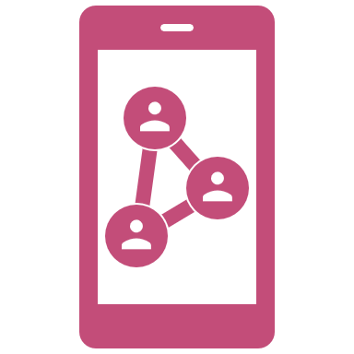
Assistive Technology

Slide 12
What it means to me
Assistive Technology (AT), along with training, persistence, and the right supports in place, has and continues to be the key instrument in my many successes throughout life.
As technology continues to evolve and social and physical barriers are removed, my journeys are becoming endless while I increase my never-ending quest for independence.

Slide 13
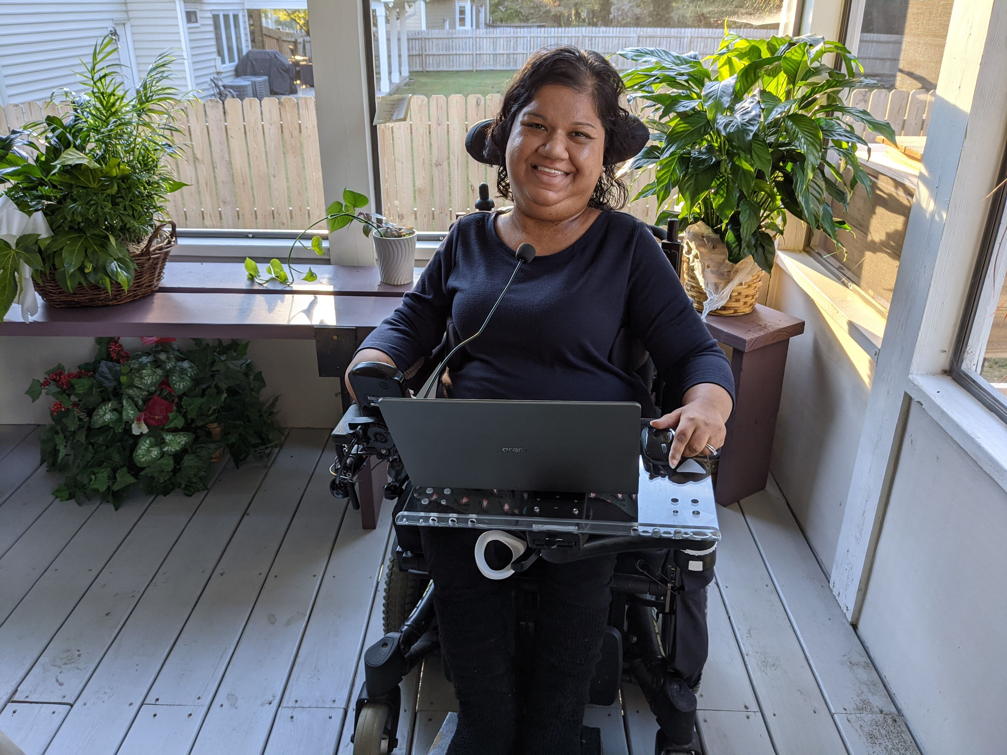
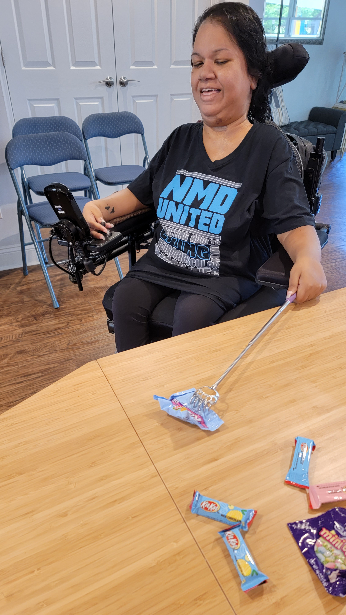
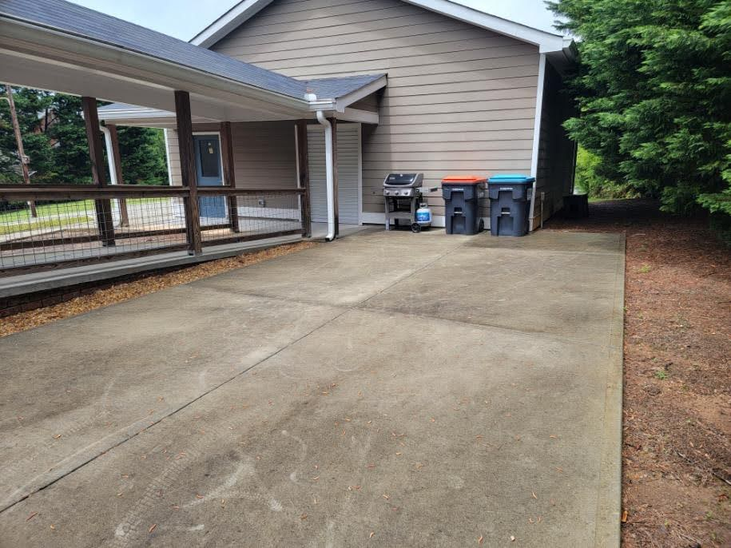
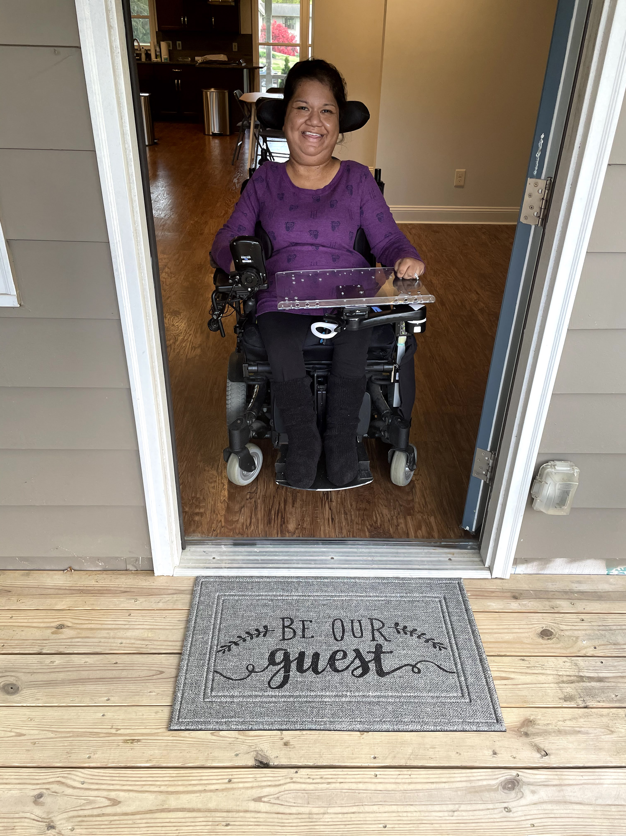
Low Tech Solutions

Slide 14
Smart Home Technology

Slide 15
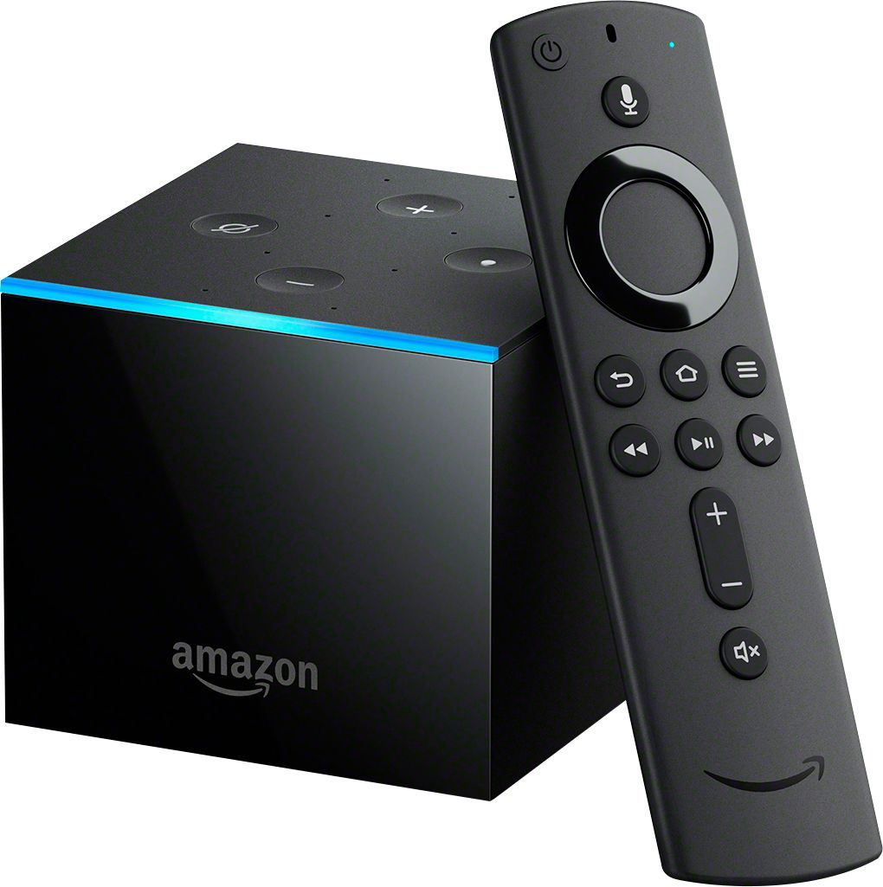
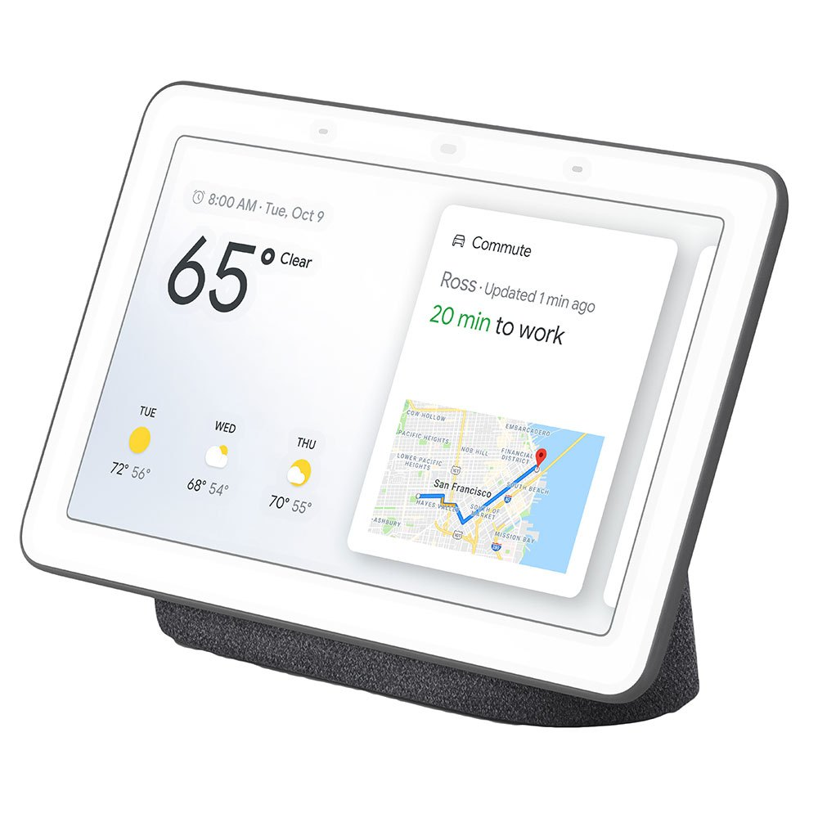
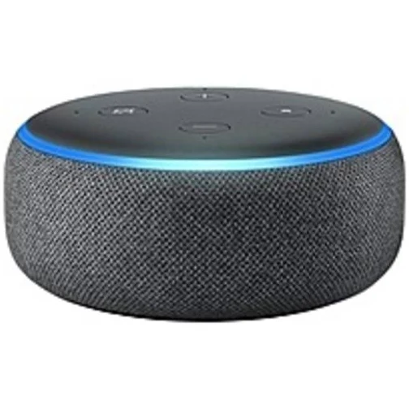
Home Assistants
Alexa, watch Bridgerton on Netflix.
Amazon Alexa
Amazon Fire TV Cube
Google Assistant

Slide 16
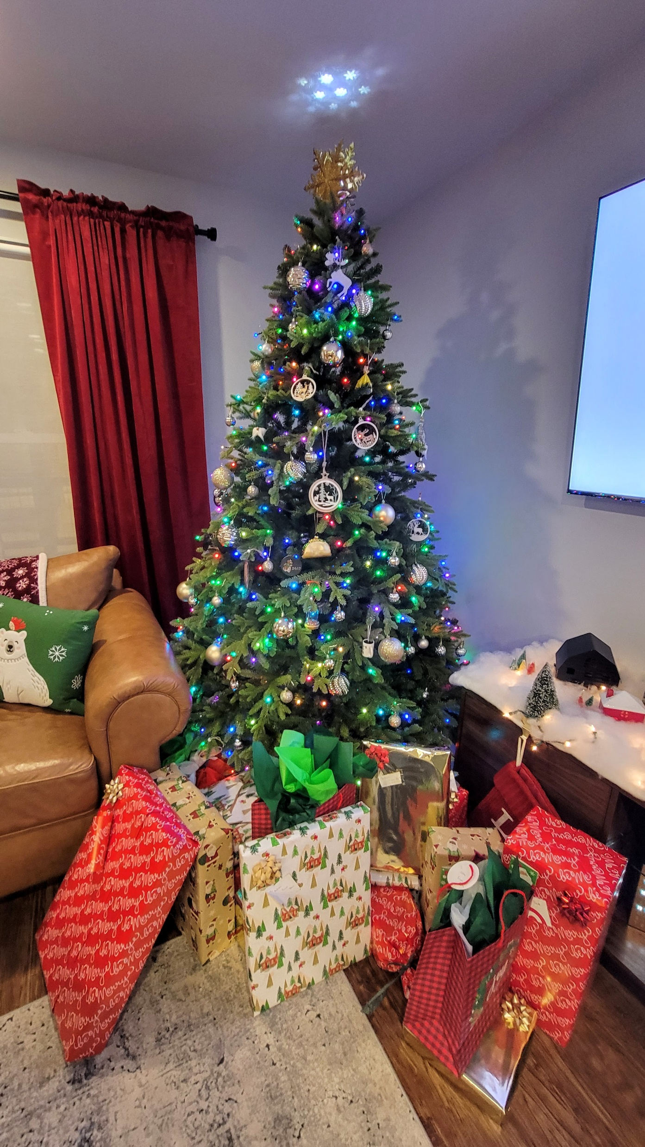
Everyday Living
Hey Google. Turn on Chris and turn on Leafy and turn on Bruce.
Hey Google. Get ready for bed.
Electric Blanket
Space Heater
Holiday Lights
Kitchen
Hey Google. I’m feeling cold.
Hey Google. Turn on the kitchen and start the coffee.

Slide 17
Home Security

Slide 18
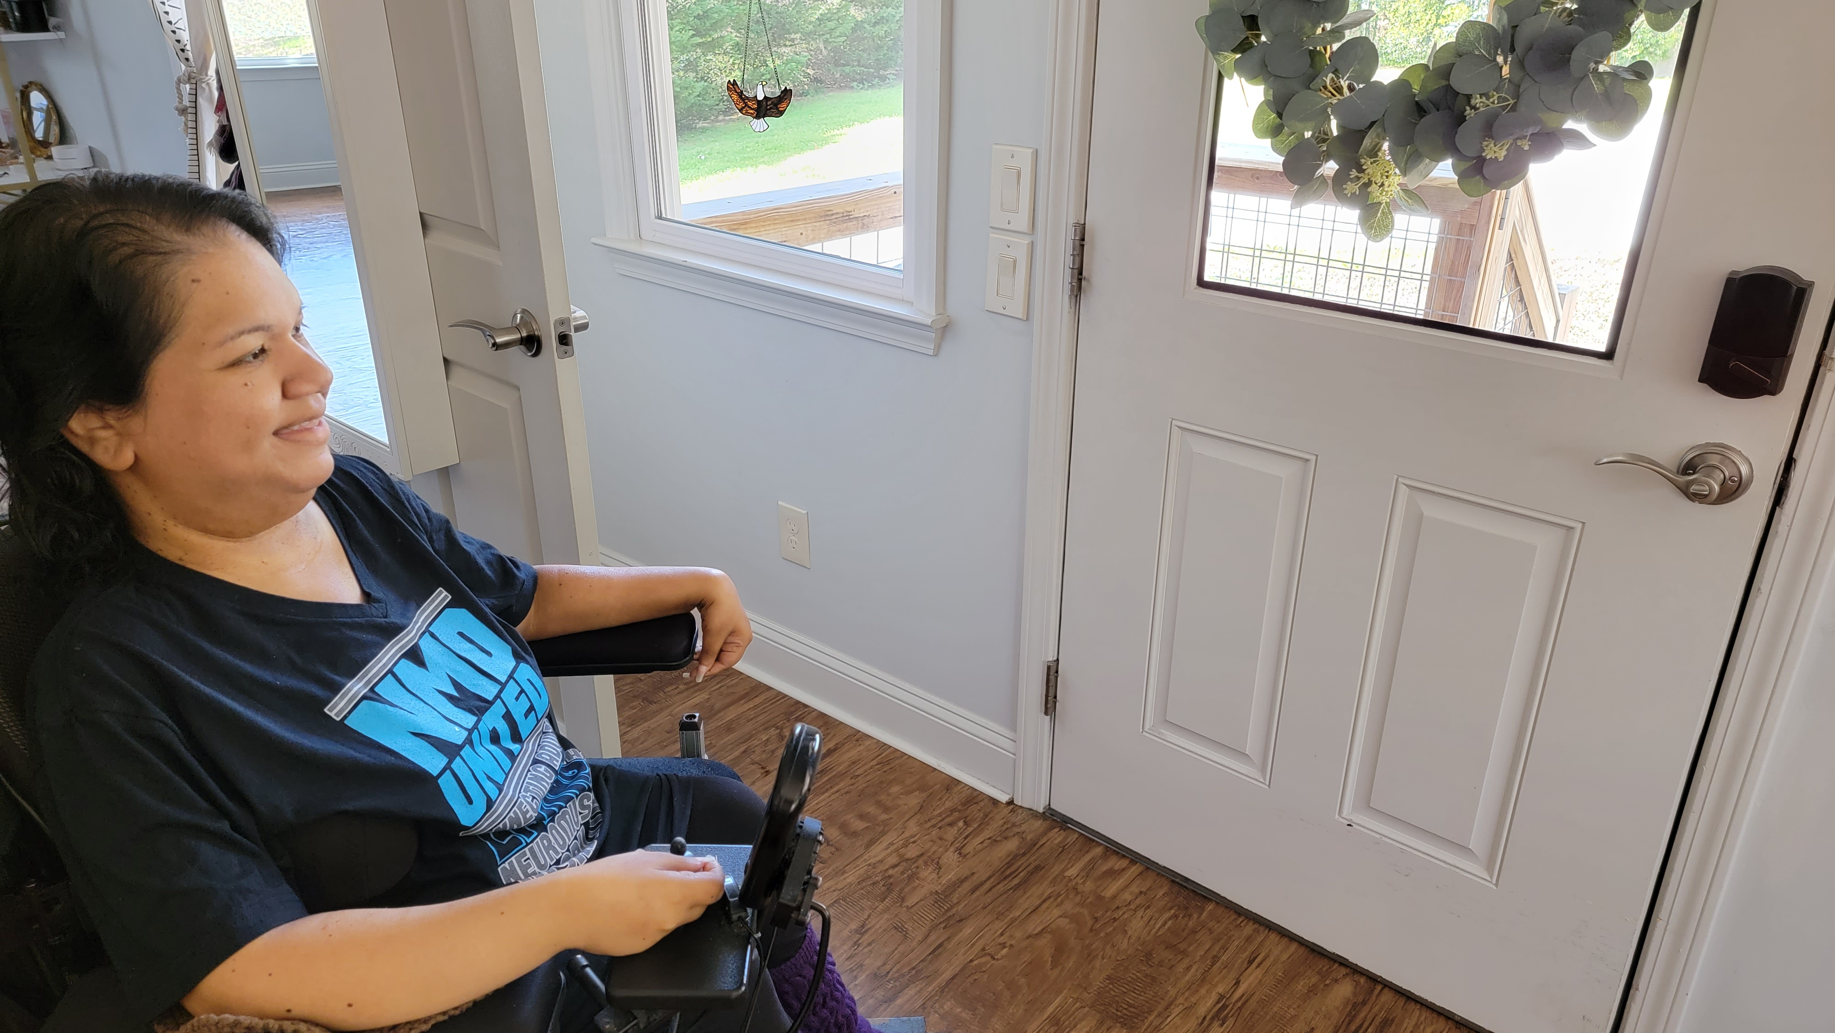
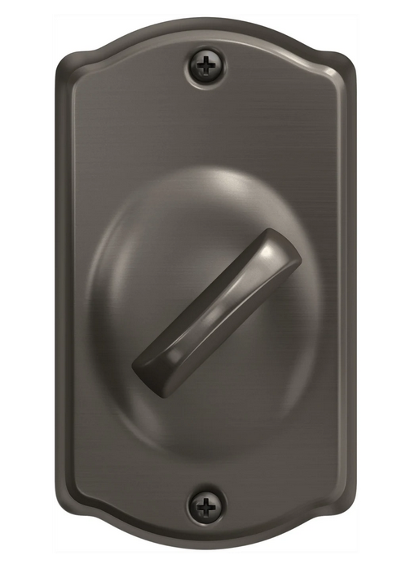
Door Lock
Hey Google! Unlock the door.

Slide 19
Garage Door
Hey Google. Ask myQ to open the garage door.

Slide 20
AT for Work

Slide 21
Home Office
I have everything I need to continue to be successful and thrive from home.
AT
Adjustable desk
Dual monitors
Microphones
Wireless micro mouse
Fresh flowers

Slide 22
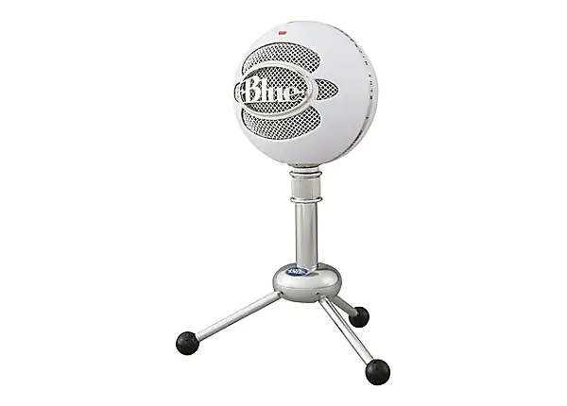
Voice Dictation and Microphone
Easy, short training
80 to 120 words per minute
Connects with the timing of your thoughts
Open documents
Access the internet
Mouse controls

Slide 23
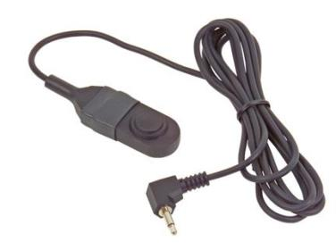
Button Switch
The ASL 305 Button Switch is a momentary switch.
Activation button the size of a dime
Requires medium force for activation.
Enables easy access to multiple wheelchair functions (tilt, recline, power legs, elevate, etc.)

Slide 24
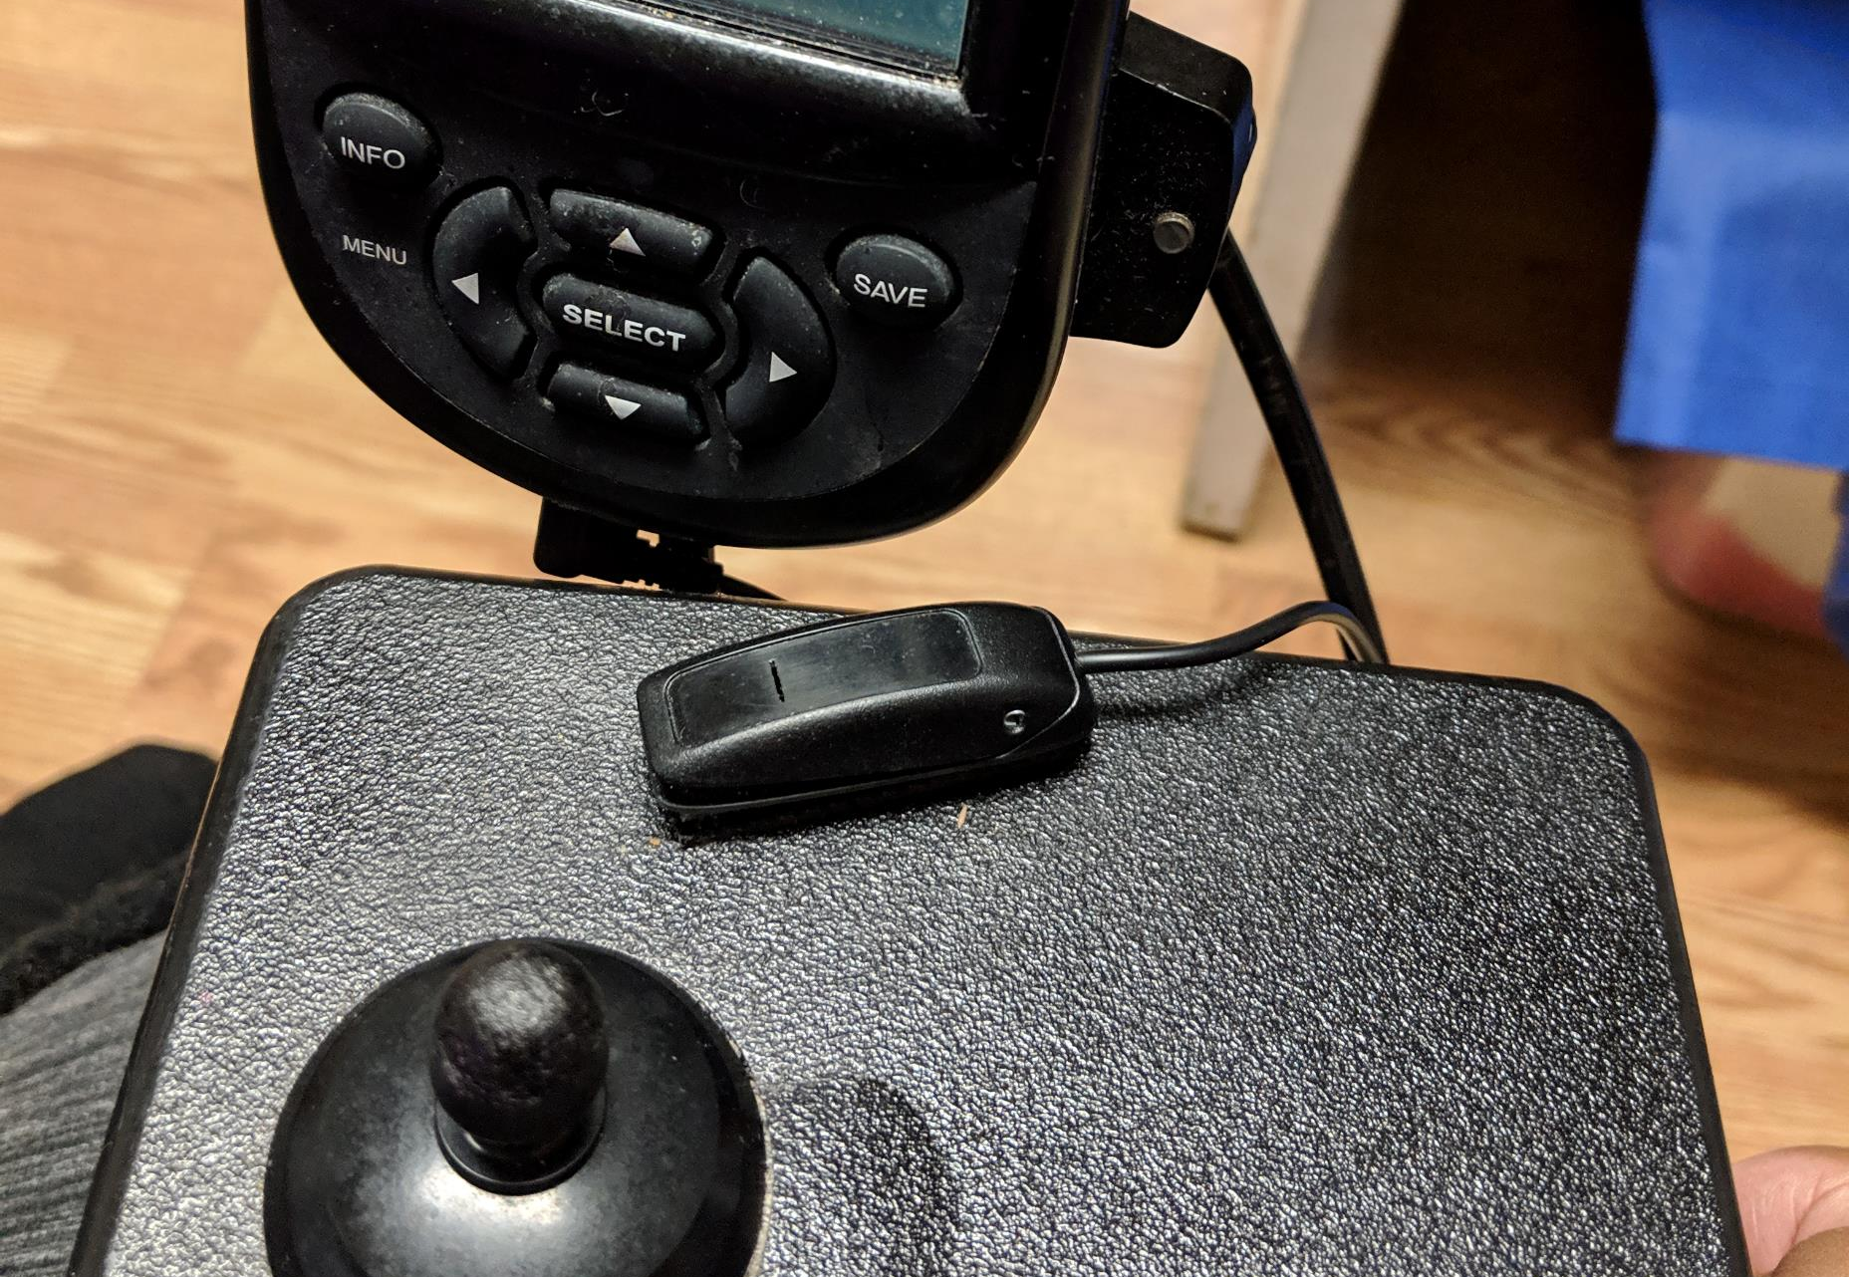
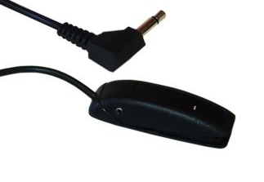
Joystick Access Ultra Light Switch
The ASL 314 Ultra Light Switch has a very light activation force and low profile.
Ideal for people with limited movement or weakness.

Slide 25
Telepresence Robot
Stay in one location while visiting another
The freedom to move around as if you’re there
Reduces travel expenses
School
Hospital and other medical settings
Work remotely

Slide 26
Flexible Work Practices
Studies show that employees are more satisfied and effective when they get to decide when, where, and how they work.
Technology is the fuel that enables these trends to grow.
Mobile devices, the cloud, collaborative software, and other advances allow for greater flexibility outside of the physical office space.

Slide 27
The Battle to Work from Home
Fought for 20 years
Constantly having to prove myself, by documenting daily tasks
Asked intimate questions about bathroom
Under pressure to go above and beyond
The dynamics changed when it affected everyone (COVID-19)

Slide 28
The Importance of Understanding Disability
There are more than one billion people with disabilities in the world who must overcome challenges every day, including stigmatization.
As a society, we are all different and must recognize the importance of acceptance.
Disability awareness is important when it comes to breaking stereotypes and overcoming preconceptions regarding disabilities.

Slide 29
NMD United, Inc.
Connecting Adults Living with Neuromuscular Disabilities
Grants
Peer Connections
Virtual Social Events
Online community
nmdunited.org

Slide 30
Disability EmpowHer Network
Disability EmpowHer Network connects, motivates, and guides disabled girls and women to grow, learn, and develop to their highest potential and have the confidence to lead.
Camp!
Letter from a Role Model
Public Speaking
Career Coaching
Blog Program

Slide 31
Ben
We teach, learn and grow together everyday.
Communication is vital.
Laughter is important.
We try to use opportunities as teaching moments. It isn’t always easy.

Slide 32
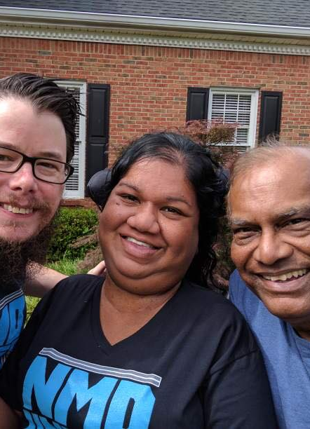
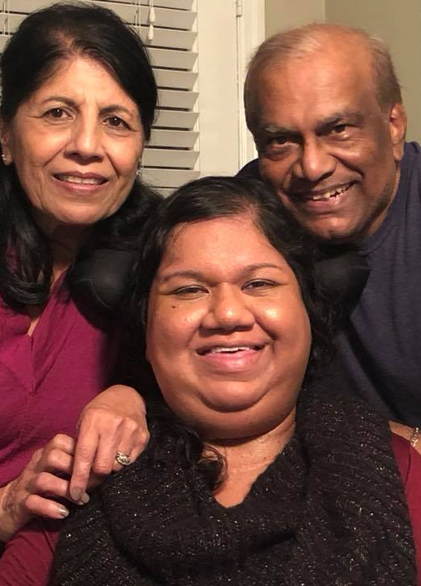
Dad
Everything good in me I have is from you.

Slide 33
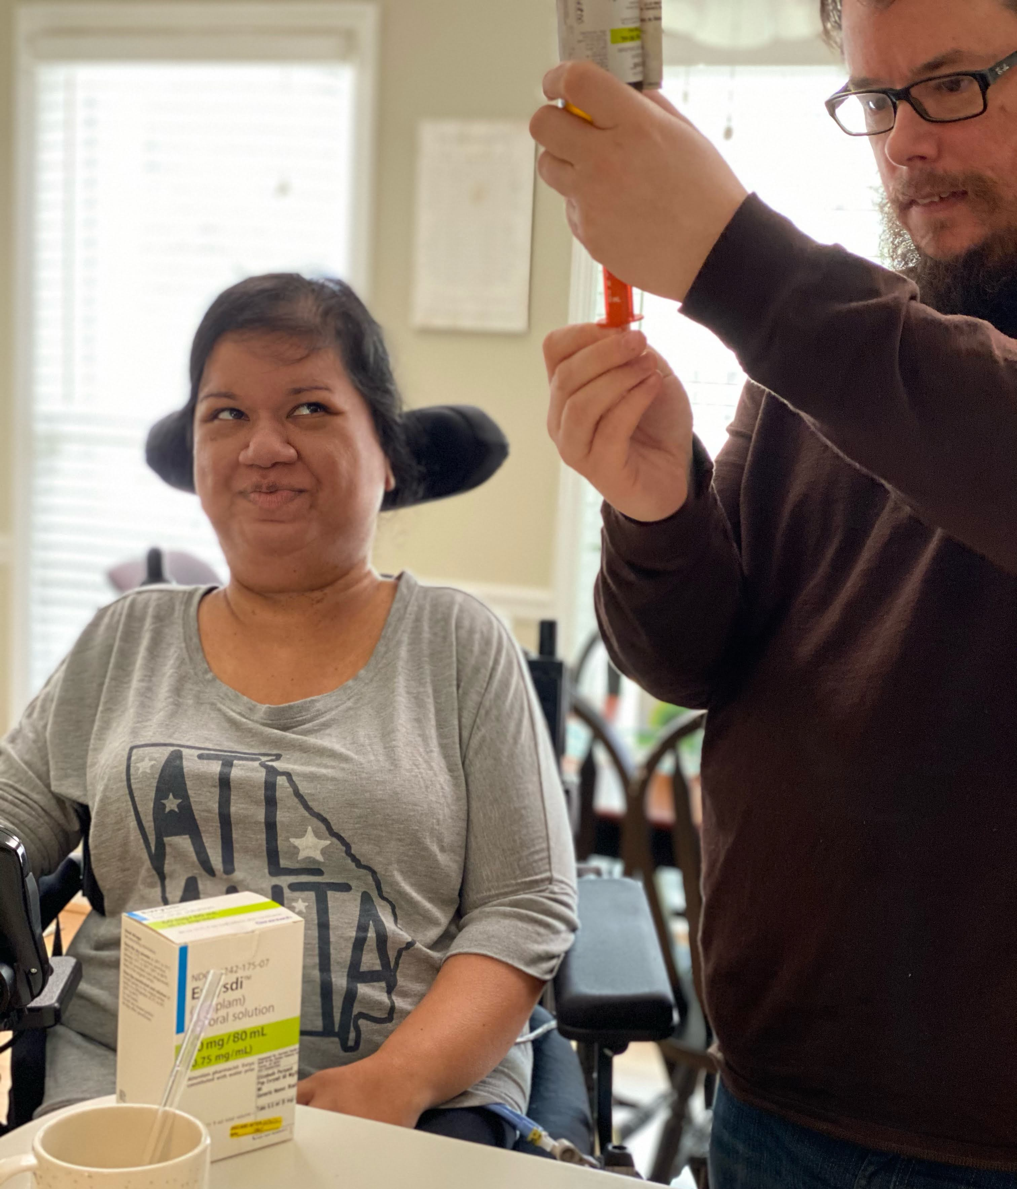
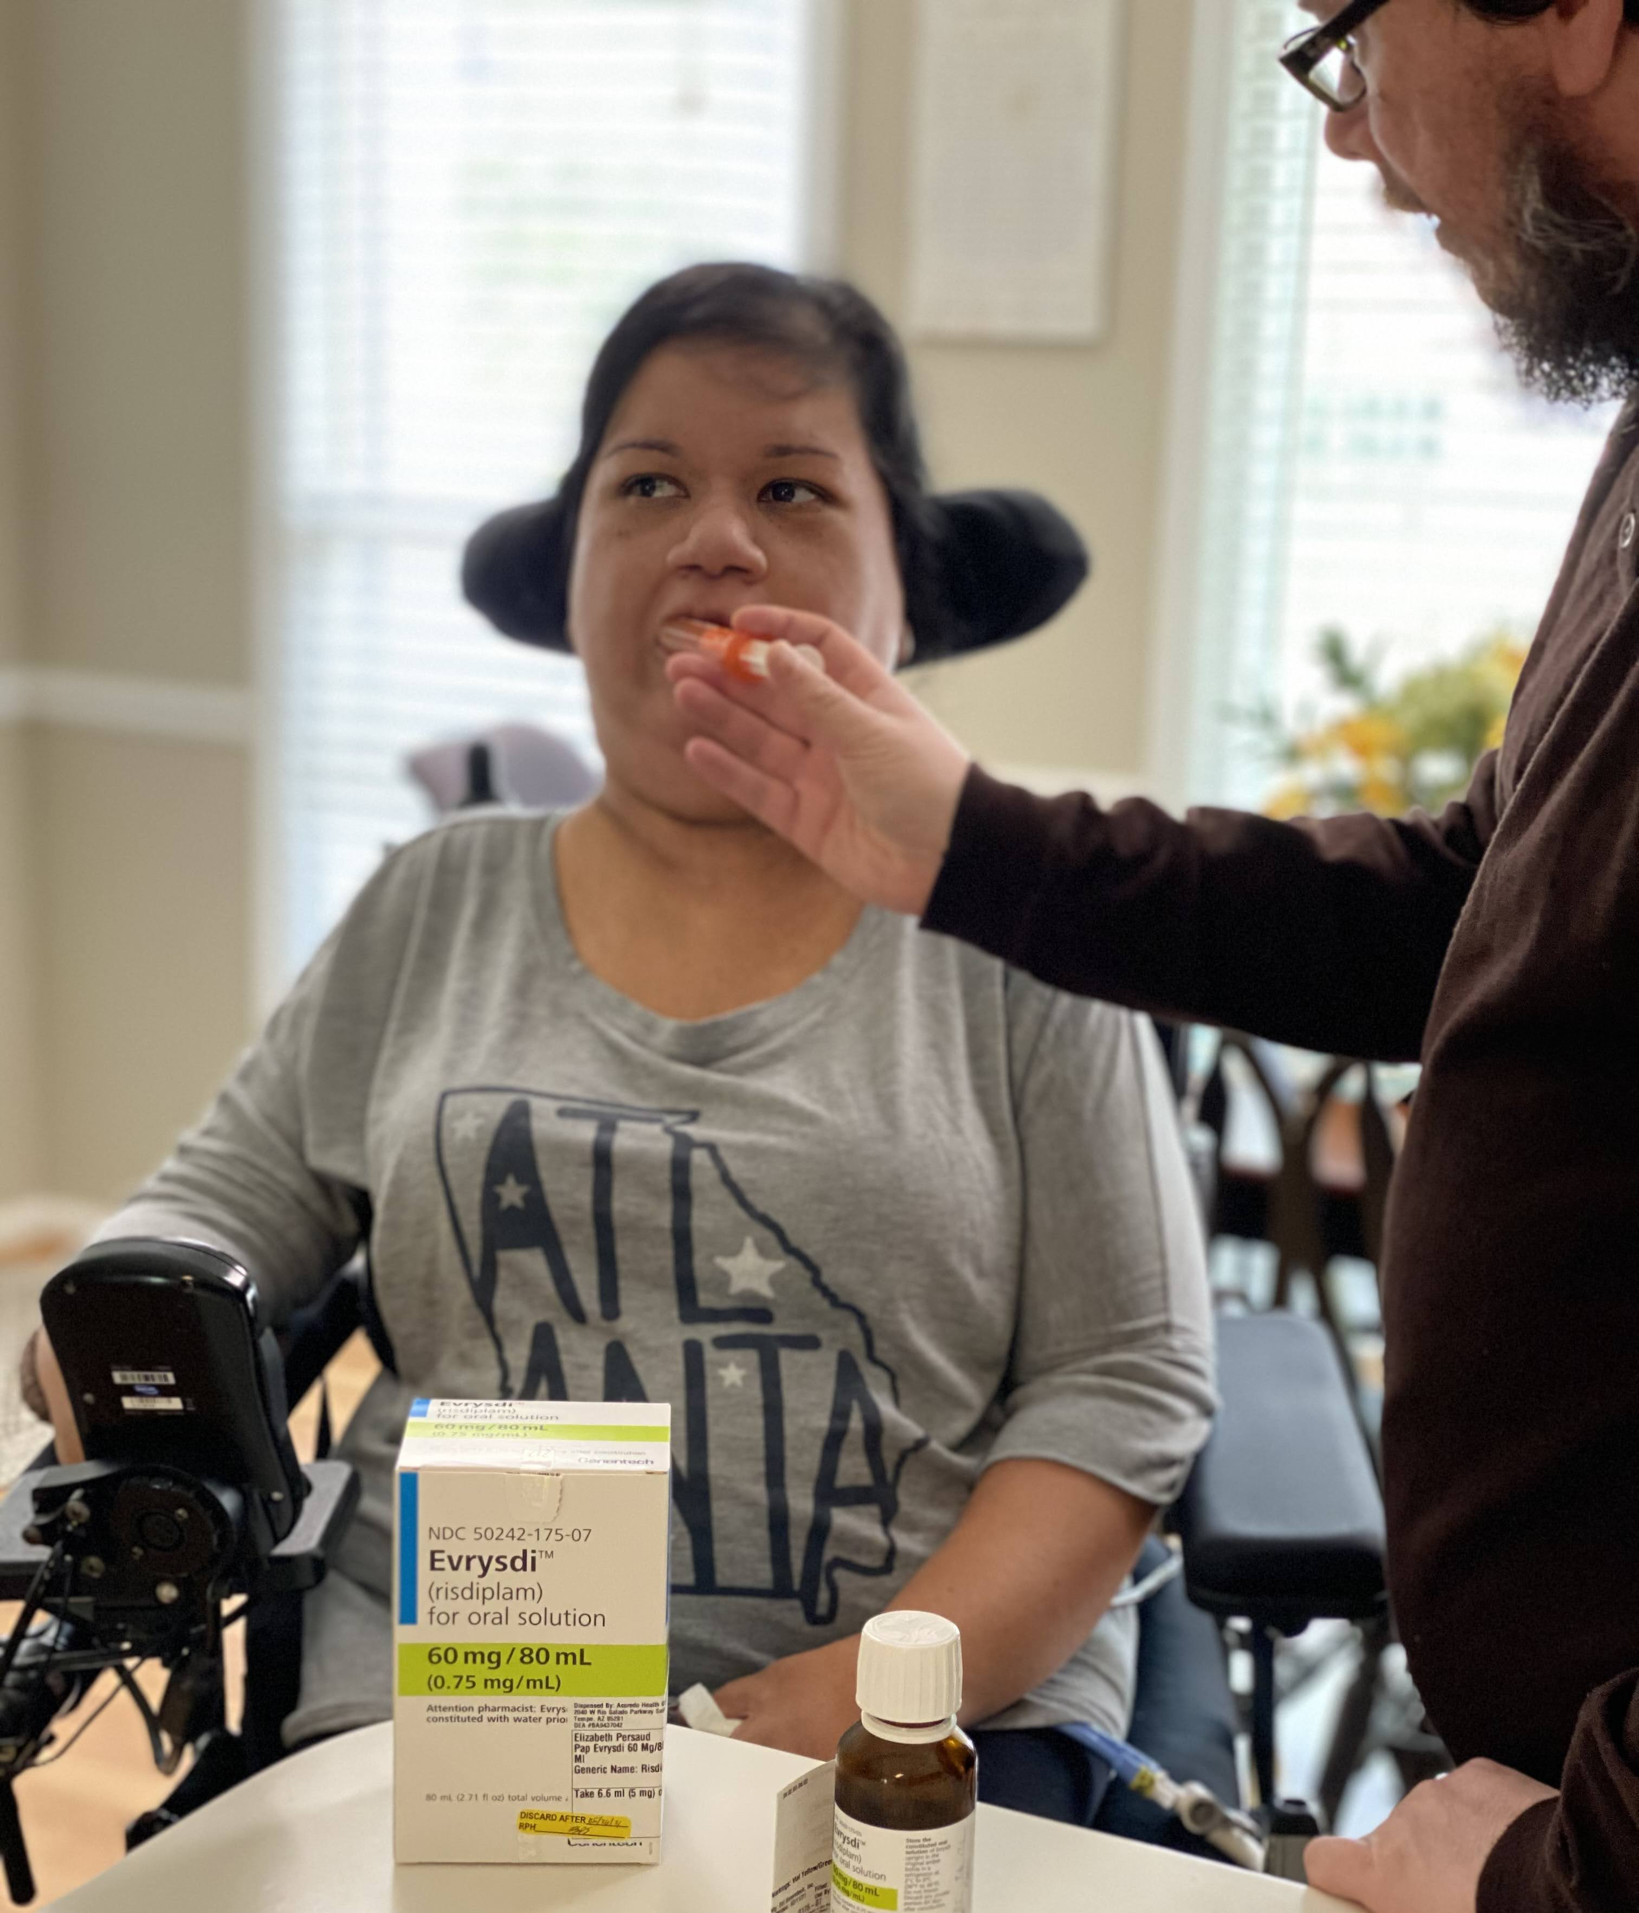
Hope
Evrysdi, the first ever FDA approved oral medication for Spinal Muscular Atrophy.

Slide 34
Lessons Learned Creating My Success
My Success relies on
Knowing myself
Self exploration
What are my goals and dreams?
Self advocacy
Speak up! When you do, they will listen.
What do I need to accomplish my goals?
Communication about my disability
Learning how to speak about my disability in positive ways
Understanding my disability
Language is powerful
Talking with caregivers, friends, co-workers, employers about my disability and listening to their point of view
Understanding my strengths and weaknesses
Managing my spoons
Knowing when to say No
Being creative
Keeping a few steps ahead at all times

Slide 35
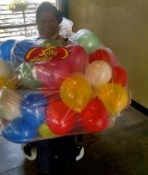
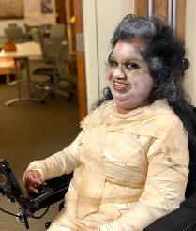
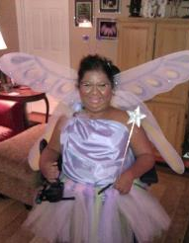
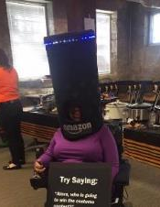
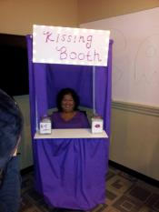
Life is Possible
For a person without a disability, technology makes Life easier.
For a person with a disability, technology makes Life possible.

Slide 36
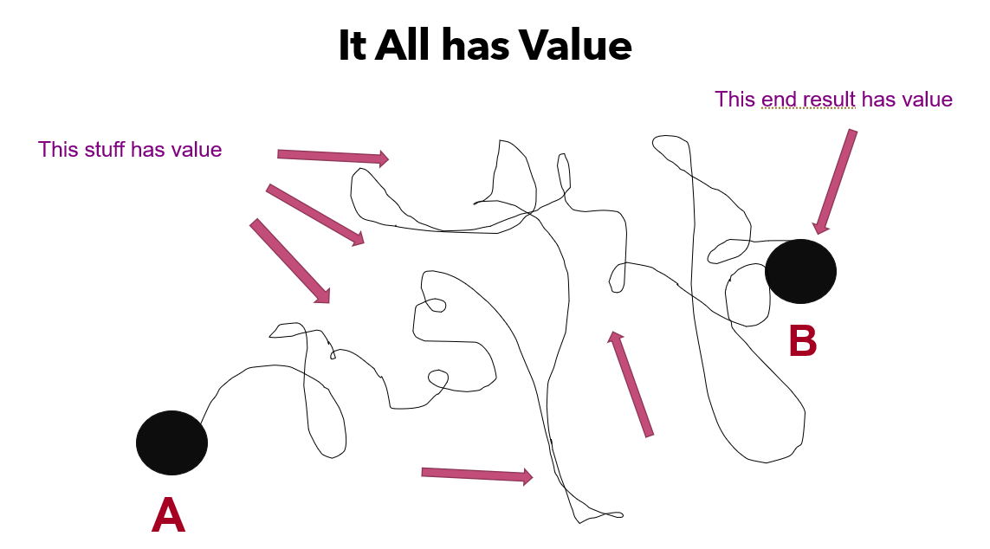
It all has value

Slide 37
Disabled Women Make History
“Equality and inclusiveness aren’t difficult ideas, nor does it need to be something that we have to prepare for in the far future. It can happen now, but we all have to do what it takes to contribute to building that inclusive society.”
~Liz Persaud

Slide 38
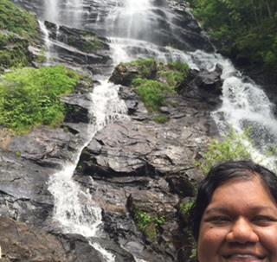
Contact Me
Liz Persaud is a nationally recognized keynote, public speaker, and advocate addressing the need to build bridges and solidify the gaps between individuals living with and without disabilities. Liz currently serves as the Program and Outreach Manager for Tools for Life, Georgia’s Assistive Technology Act Program at the Center for Inclusive Design and Innovation within the College of Design at Georgia Tech. She is a sought-after guest lecturer at numerous universities speaking on the power of assistive technology. Liz also serves on the Board of Directors at NMD United, Inc., a non-profit organization led by adults living with neuromuscular disabilities and provides outreach and raises disability awareness to numerous groups and organizations across the globe. Her passion lies within education about generations of adults growing up and living independently and successfully with childhood neuromuscular diseases. Additionally, Liz serves on the Board for the Disability EmpowHer Network, a non-profit that connects, motivates, and guides disabled girls and women to grow, learn, and develop to their highest potential and have the confidence to lead. Liz has dedicated her life to increasing independence for individuals with disabilities by educating on self-determination and advocacy with a focus on technology, disabilities and relationships. She is a graduate of Georgia State University and lives in Marietta, Georgia with her hero of a husband.
To contact Liz, please email lizpersaud@gmail.com.

